Slide 1


Slide 2
About today…
JavaScript Variables
Variable Naming

Slide 3


Slide 4



Definition
Variables are containers for storing data values
They are fundamental to programming
They allow us to work with and manipulate data in our code
a3
a1
a2

Slide 5
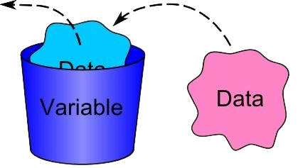
Importance
Enable us to
Store and retrieve data
Perform calculations
Control the flow of our programs
By storing values that can change during execution

Slide 6
Variable Declaration using var, let, and const
var:
Traditionally used for variable declaration in JavaScript, but it has some drawbacks such as function scope and potential hoisting issues
let:
Introduced in ES6, it provides block scope and is preferred over ‘var’ for most scenarios
const:
Also introduced in ES6, it declares constants whose values cannot be changed once assigned
ES6 stands for ECMAScript 6. ECMAScript was created to standardize JavaScript

Slide 7
Examples
let firstName = 'John';
Declaring a variable firstName using let.
const PI = 3.14;
Declaring a constant PI with the value of pi.
var age = 30;
Declaring a variable age using var

Slide 8
What are variables in JavaScript, and why are they important?
How do we declare and use variables in JavaScript?

Slide 9


Slide 10
Importance
Improve
code readability
maintainability
collaboration among developers
Consistent naming makes it easier to understand the purpose of variables

Slide 11
Guidelines
Use descriptive names that reflect the variable's purpose
firstName instead of fn
Start variable names with letters, underscores, or dollar signs
Avoid using reserved words and special characters except underscores or dollar signs
Use camelCase for multi-word variable names
firstName instead of first_name

Slide 12
Which naming convention is recommended for JavaScript variables with multiple words?
snake_case
kebab-case
camelCase

Slide 13


Slide 14
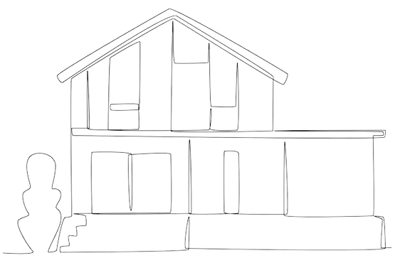
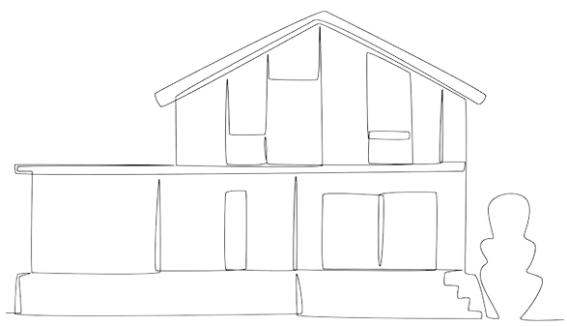


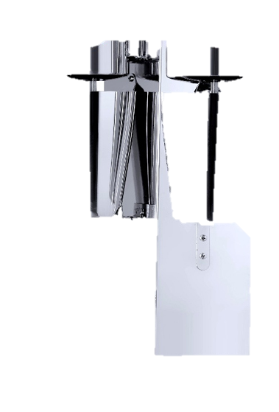

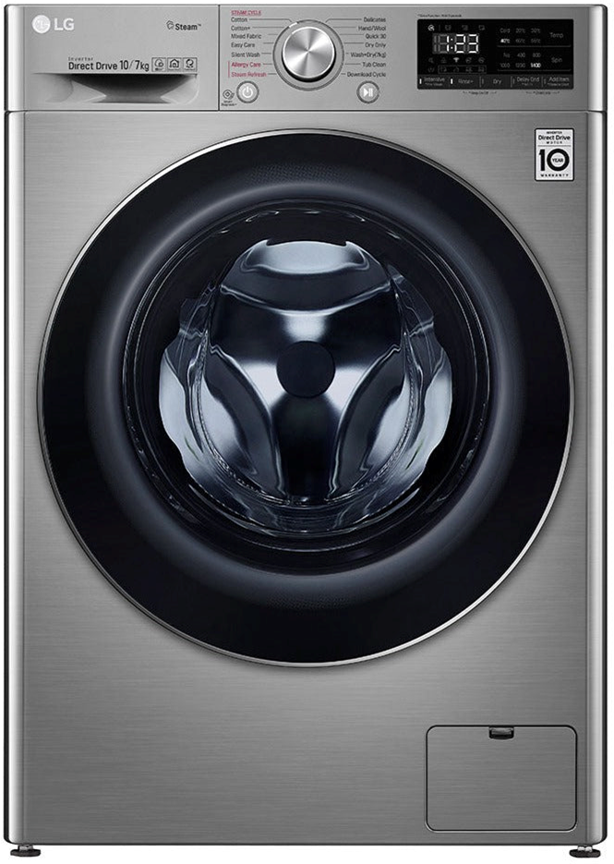


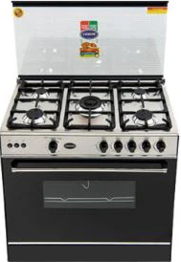
Definition
Where a specific variable is visible / accessible.

Slide 15
Explanation
‘‘var’ has function scope, meaning variables are accessible throughout the function where they are declared.
‘let’ and ‘const’ have block scope, limiting their accessibility to the block (enclosed within {}) where they are defined

Slide 16
Which type of variable has block scope in JavaScript?
var
let
const

Slide 17


Slide 18

Write a simple JavaScript program that demonstrates the naming variables as per conventions and demonstrate their scope.

Slide 19
Home Work
Practice
Variable naming
Variable scope
NEXT
JavaScript variables and naming conventions

Slide 20
Create an HTML page with a button that opens 3 alert messages getting user name and two numbers from the user and store those values in appropriate variables. Finally printing the message in the following format :
“Hi <user>, <firstnumber>+<secondnumber>=<result>"

